Slide 1
HACKATHON SPRING 2019
HACKER BOYS
USE CASE: PARKING MANAGEMENT
SANTHOSH GANDHI DIDDI VENKATA SAI TEJA YERRANAGULA MOURYA PRAHARSHA BOBBILI SAI TEJA PENUGONDA

Slide 2
PARKING MANAGEMENT FEATURES
This web application scans the number plate of cars and fetches the details of that car.
For the first time the user gets registered and the details are stored in a database.
After that it checks the parking lot for empty spaces.
If any space is available , it assigns the slot to that car.
If there are no empty slots, it tells the user that there are no more spaces available.
While going out, it agains scans the number plate and removes the car from that slot and makes that slot empty.

Slide 3
TECHNOLOGIES USED
HTML
CSS
BOOTSTRAP
ANGULAR JS
JQUERY
TESSERACT

Slide 4
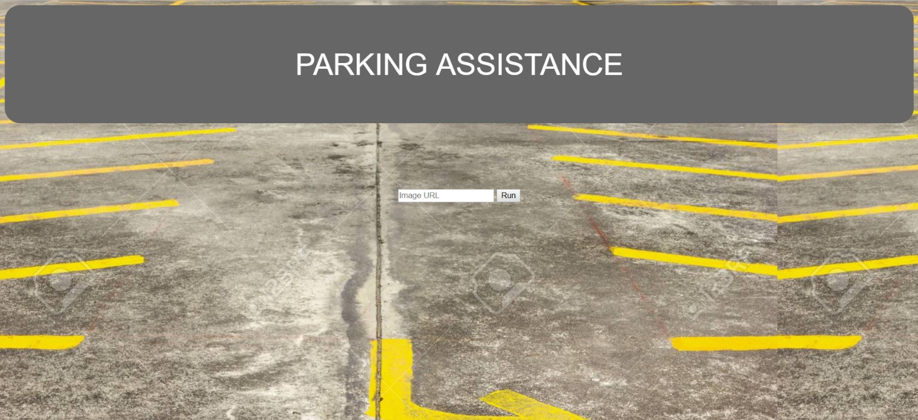

Slide 5
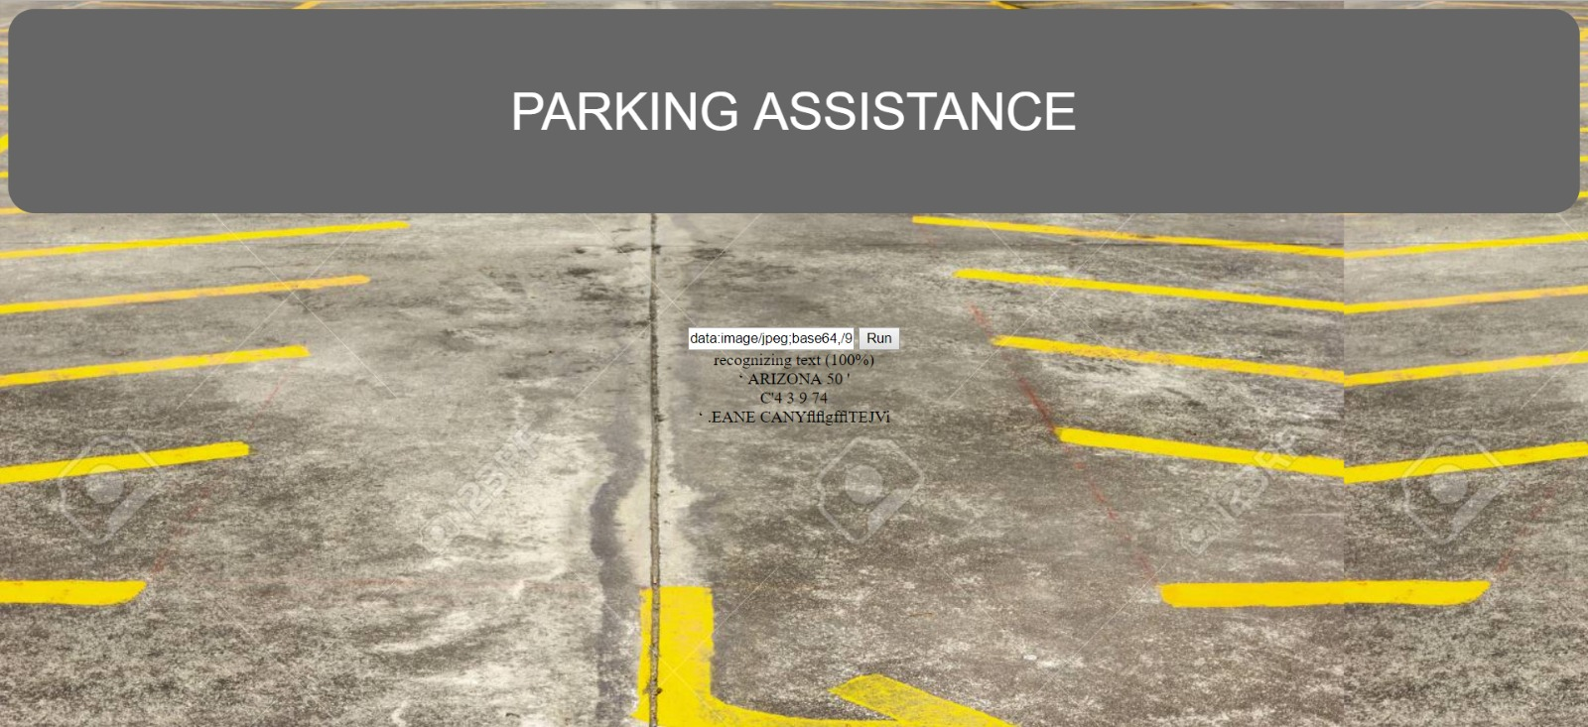

Slide 6
REFERENCES:
Google.com
https://progur.com/2016/10/how-to-use-tesseract-for-ocr-javascript.html
https://ieeexplore.ieee.org/document/5941663
GITHUB LINK:
https://github.com/saiteja1015/hackathon_spring_2019
YOUTUBE LINK:
https://www.youtube.com/channel/UCAbNyK0JPUfdpfKMiJ4YVqg?view_as=subscriber

Slide 7
THANK
YOU

